Slide 1
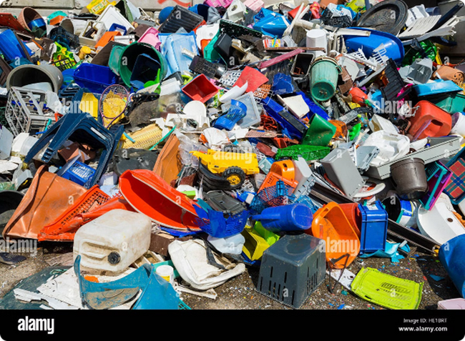
USRF - 2024
USRF0006/USRF0015
Undergraduate Summer Research Fellowship - 2024
Classification of Biodegradable and non-Biodegradable waste using MobileNetV2
With Multi-Head Attention Mechanism
Abhishek Kumar
(National institute of technology,Manipur)
Piyush Kumar Pandey
(IIM college of engineering)
Mentor : Dr. Ritesh Maurya & Dr.Garima Aggarwal
Assistant Professor
at Amity Centre for Artificial Intelligence

Slide 2
USRF - 2024
USRF0006/USRF0015
Objective
The primary objective of this project are to:
Develop a robust image classification model: Utilize MobileNetV2 and multi-head attention to accurately classify biodegradable and non-biodegradable waste.
Achieve high accuracy: Ensure the model performs well on both training and validation datasets.
Deploy the model in a mobile application: Create an accessible and user-friendly app using Flutter to enable real-time waste classification.
Promote environmental awareness: Encourage proper waste management practices through the application of advanced AI technologies.

Slide 3

USRF - 2024
USRF0006/USRF0015
Introduction
Project Overview: The goal of this project is to develop an advanced image classification model capable of distinguishing between biodegradable and non-biodegradable waste. By leveraging the power of transfer learning with the MobileNetV2 model and enhancing it with a multi-head attention mechanism, the project aims to achieve high accuracy in waste classification. The final model is deployed as a mobile application using Flutter, making it accessible and user-friendly for real-world use.

Slide 4
USRF - 2024
USRF0006/USRF0015
Importance
Classifying biodegradable and non-biodegradable waste is crucial for effective waste management and environmental sustainability. Accurate classification helps in:
Waste Segregation: Ensuring proper disposal and recycling processes.
Environmental Impact: Reducing pollution and conserving natural resources.
Public Health: Minimizing health hazards associated with improper waste disposal.
Economic Efficiency: Enhancing recycling efficiency and reducing waste management costs.
This project not only contributes to technological advancements in AI but also addresses significant environmental and societal challenges.

Slide 5
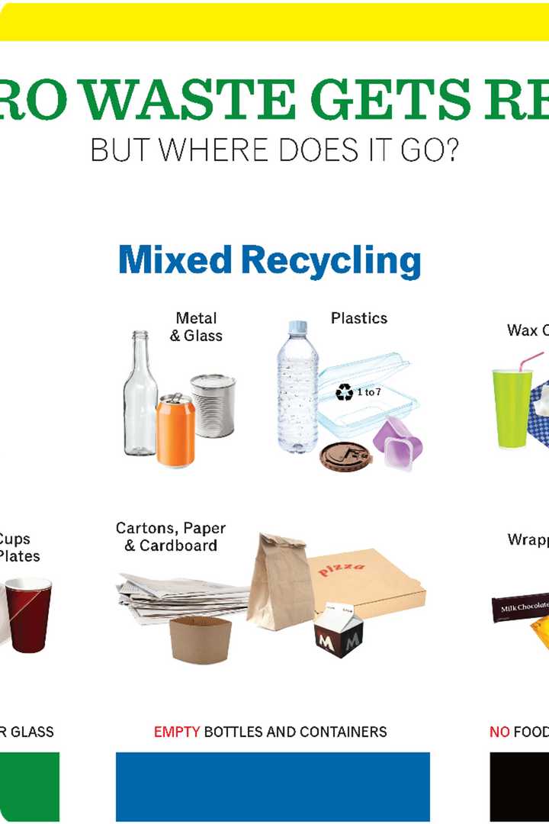
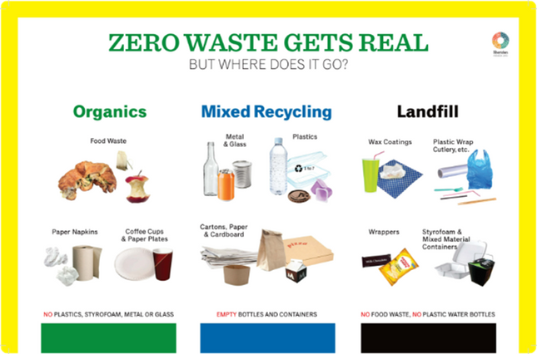
USRF - 2024
USRF0006/USRF0015
Problem Statement
Problem: The increasing volume of waste generated globally presents significant challenges to waste management systems. Improper disposal of waste leads to environmental pollution, health hazards, and inefficient resource use. A major part of the problem is the difficulty in accurately and efficiently classifying waste into biodegradable and non-biodegradable categories. Traditional methods of waste classification are labor-intensive, prone to errors, and not scalable. This highlights the need for an automated, accurate, and scalable solution to assist in waste segregation.

Slide 6
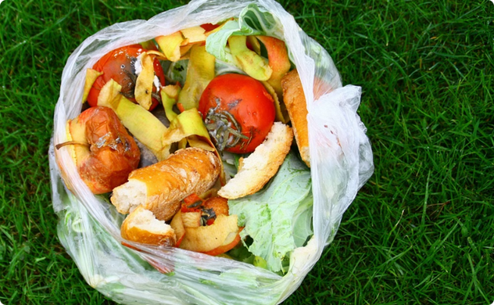

USRF - 2024
USRF0006/USRF0015
Dataset
Description:
Classes: The dataset consists of images classified into two categories: biodegradable and non-biodegradable waste.
Training Set: Contains 30,000images of biodegradable waste and 30,000 images of non-biodegradable waste, totaling 60,000 training images.
Test Set: Contains 8,363 images of biodegradable waste and 8,363 images of non-biodegradable waste, totaling 16,726 test images.
Image Sources: Images were collected from the kaggle website.
Biodegradable Waste
Non-Biodegradable Waste

Slide 7
USRF - 2024
USRF0006/USRF0015
Dataset Description
Resizing: All images were resized to a consistent dimension to fit the input requirements of the MobileNetV2 model (96x96 pixels).
Normalization: Pixel values were normalized to a range of 0 to 1 to standardize the input data and improve model convergence.
Augmentation: Data augmentation techniques such as random rotations, flips, and zooms were applied to increase the variability of the training data and reduce overfitting.
Label Encoding: The class labels (biodegradable and non-biodegradable) were encoded as binary values (0 and 1) for compatibility with the model's output layer.
These preprocessing steps ensure that the dataset is clean, standardized, and suitable for training an accurate and robust image classification model.

Slide 8
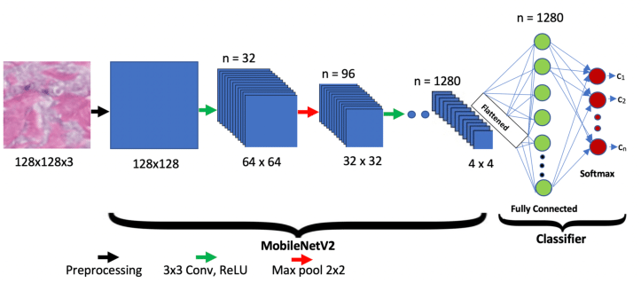
USRF - 2024
USRF0006/USRF0015
Model Architecture
Base Model:
MobileNetV2: Utilized as the base model for its efficiency and accuracy in image classification tasks.
Untrainable Layers: Layers 1 to 13 are set as untrainable to leverage pre-trained features from ImageNet.
Trainable Layers:Layers 14 to 53 are set as trainable to fine-tune the model on our specific dataset.

Slide 9
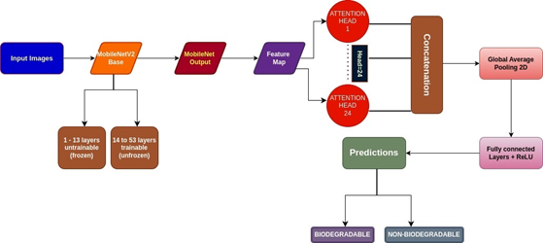
USRF - 2024
USRF0006/USRF0015
Attention Mechanism:
Multi-Head Attention Layer:
Heads: 24 attention heads.
Key Dimensions: 8 dimensions for each key.
This mechanism allows the model to focus on different parts of the image simultaneously, enhancing its ability to distinguish between biodegradable and non-biodegradable waste.

Slide 10

USRF - 2024
USRF0006/USRF0015
Training and Evaluation
We trained the model using standard techniques like data augmentation and cross-validation. Evaluation metrics include accuracy, precision, recall, and F1-score, measured on held-out test data.
1.
Data Preprocessing
Resizing, normalization, and data augmentation to improve generalization.
2.
Model Training
Leveraging transfer learning and fine-tuning the model on our dataset.
3.
Performance Evaluation
Validating the model's performance on unseen test data.

Slide 11
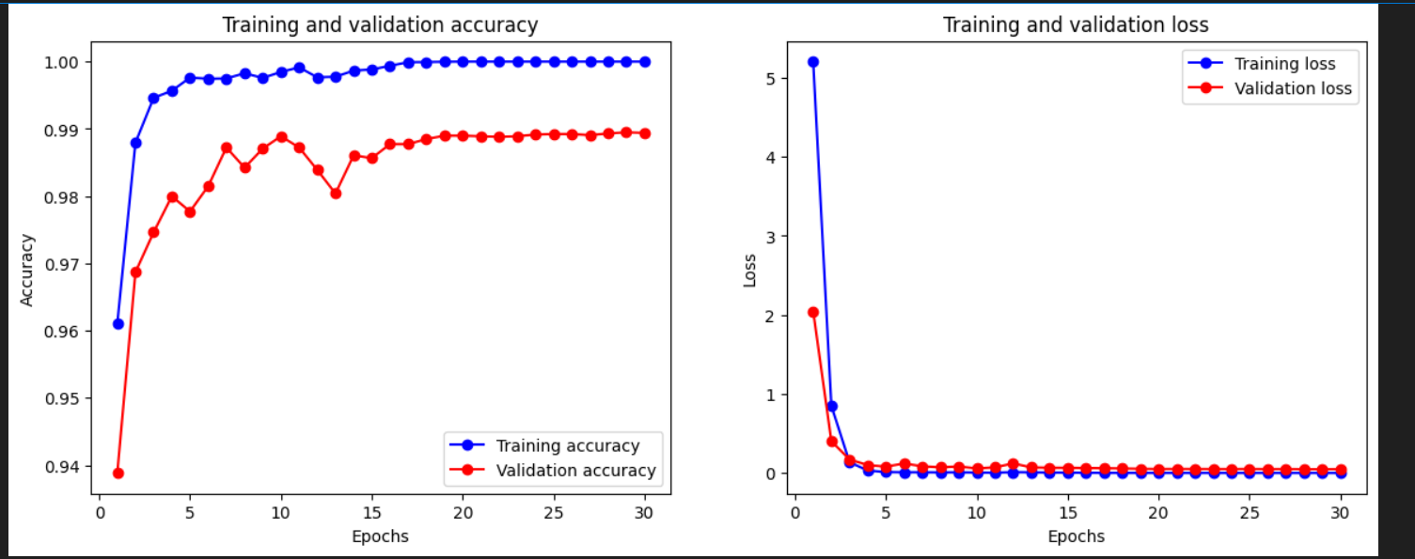
USRF - 2024
USRF0006/USRF0015
Results
Accuracy & Loss

Slide 12
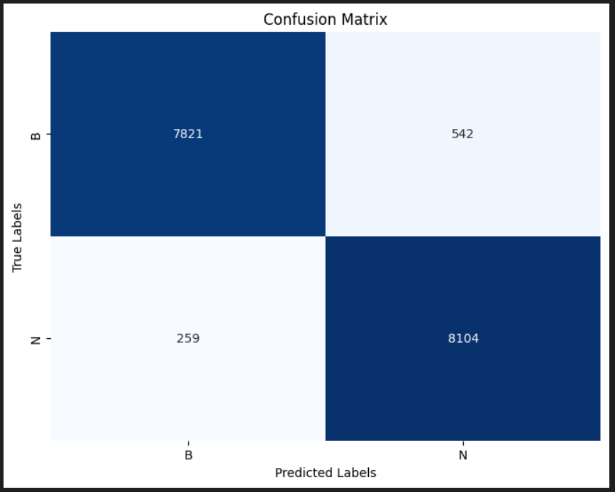
USRF - 2024
USRF0006/USRF0015
Confusion Matrix

Slide 13
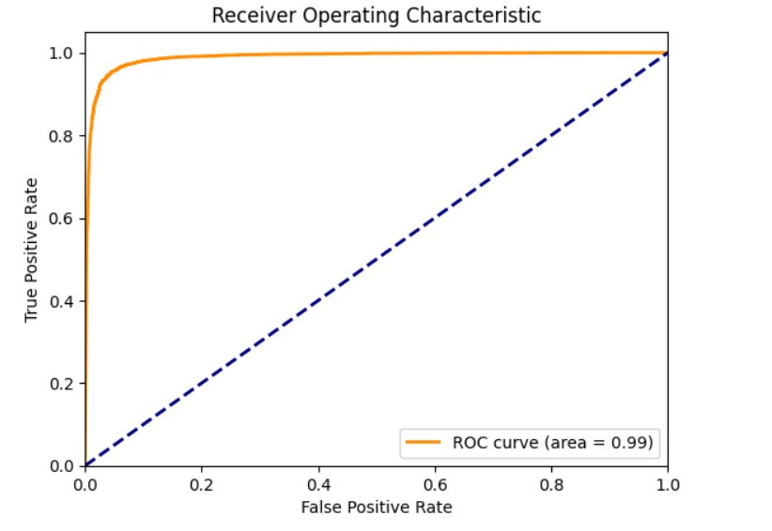
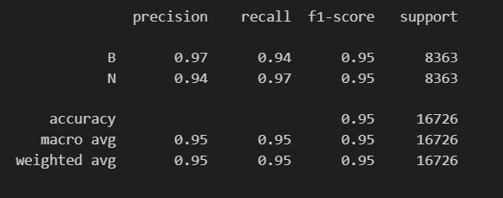
USRF - 2024
USRF0006/USRF0015
Performance
ROC Curve

Slide 14
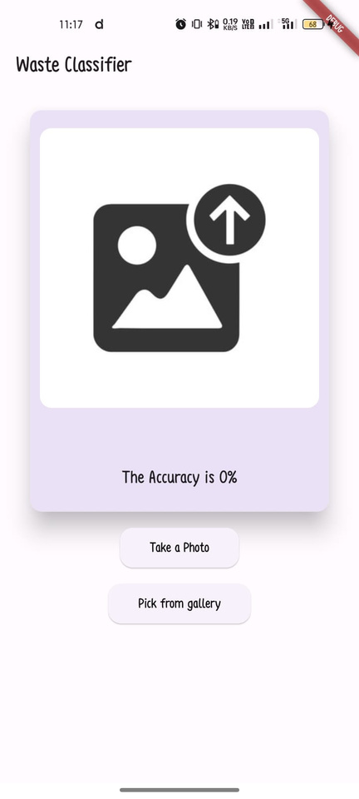
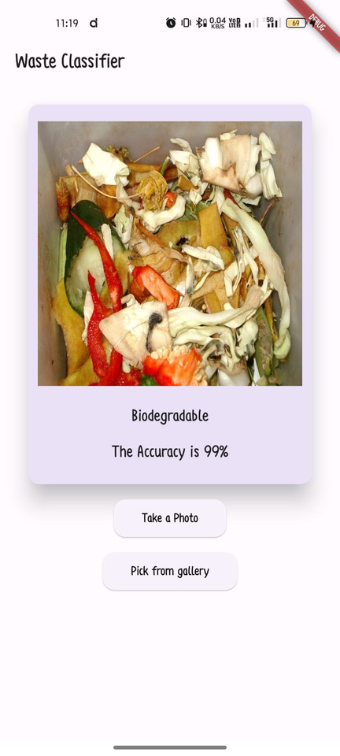
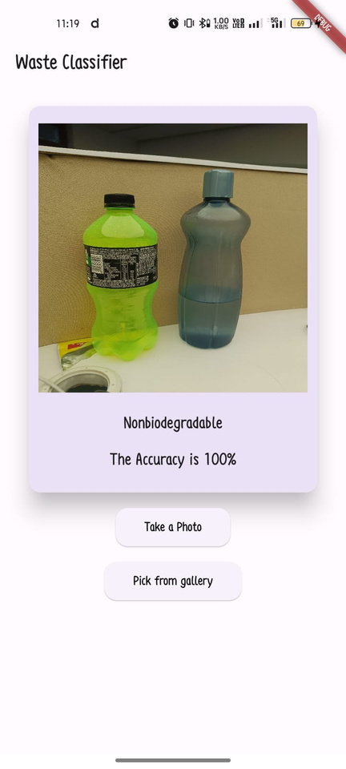
USRF - 2024
USRF0006/USRF0015
Deployment

Slide 15

USRF - 2024
USRF0006/USRF0015
Limitations and Challenges
While our model performs well, there are still some limitations and challenges to address. These include handling low-quality or occluded images, as well as expanding the dataset to cover a wider range of waste materials.
Image Quality
Dataset Expansion
Real-World Deployment
The model's performance may degrade on low-quality or partially occluded images.
Expanding the dataset to include more diverse waste materials could improve the model's generalization.
Integrating the model into a practical waste management system poses additional engineering challenges.

Slide 16
USRF - 2024
USRF0006/USRF0015
Conclusion
In conclusion, our project successfully developed and deployed an advanced image classification system for distinguishing biodegradable and non-biodegradable waste. By leveraging MobileNetV2 with a multi-head attention mechanism, we achieved high accuracy and efficiency in waste classification. The model's deployment in a Flutter-based mobile application ensures widespread accessibility and practical usability for promoting sustainable waste management practices. Through rigorous training, validation, and deployment processes, we have demonstrated the capability of AI to enhance environmental sustainability by facilitating accurate waste segregation. Moving forward, ongoing refinements and expansions in model capabilities promise even greater impact in optimizing waste disposal and recycling efforts globally.

Slide 17




USRF - 2024
USRF0006/USRF0015
Thank You

